Slide 1
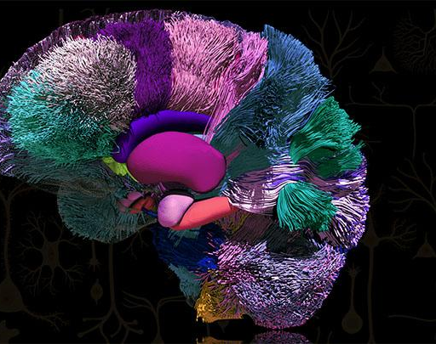
Postgraduate Course Professional Training in Research with focus in Neuroscience
Faculty
J. Joireman
Dept. of Marketing and International Business, Washington State University
Leticia Méndez and Leticia Tejera
CSIC, UdelaR
David Resnik
NIH/NIEHS
Marco A.M. Prado
Journal of Neurochemistry
Harry W.M. Steinbusch
Journal of Chemical Neuroanatomy
Germán. Sumbre
INSERM, Ecole Normale Supérieure, Paris. France. Avenir team
Shari Wiseman
Nature Neuroscience
Organizers:
Alejandro Vásquez
María E. Castelló
IIBCE, MEC
September 19th – 24th 2022
IIBCE
Applications (deadline September 16th):
Uruguayan students: Bedelía School of Science
Regional students: lden.iibce@gmail.com

